Slide 1
variance
Dr. Srinibash Dash
School of Management
Gangadhar Meher University
Sambalpu Dr. Srinibash Dash
School of Management
Gangadhar Meher University

Slide 2
CONTENTS:
INTRODUCTION
WHAT IS VARIANCE?
VARIANCE FOR UNGROUPED DATA
HOW TO CALCULATE VARIANCE?
SOLVED PROBLEM
REFERENCES
CONCLUSION

Slide 3
Introduction: variance
Variance is the square of the standard deviation.
In short, having obtained the value of the standard deviation, you can already determine the value of the variance.
It follows then that similar process will be observed in calculating both standard deviation and variance.
It is only the square root symbol that makes standard deviation different from variance.

Slide 4

Variance for ungrouped data:
$s^{2}=\frac{\sum{{\left(x−\overline{x}\right)}^{2}}}{n−1}$
where,$x$= value of observations
$\overline{x}=$ sample mean
$n=$ total no. of values in population

Slide 5
How to calculate the variance for ungrouped data:
Find the mean.
Calculate the difference between each score and the mean.
Square the difference between each score and the mean.
Add up all the squares of the difference between each score and the mean.
Divide the obtained sum by n-1.

Slide 6
Find the variance:
35 73
35 11
35 49
35 35
35 15
35 27
--------- ---------
210 210
MEAN=35 MEAN=35

Slide 7
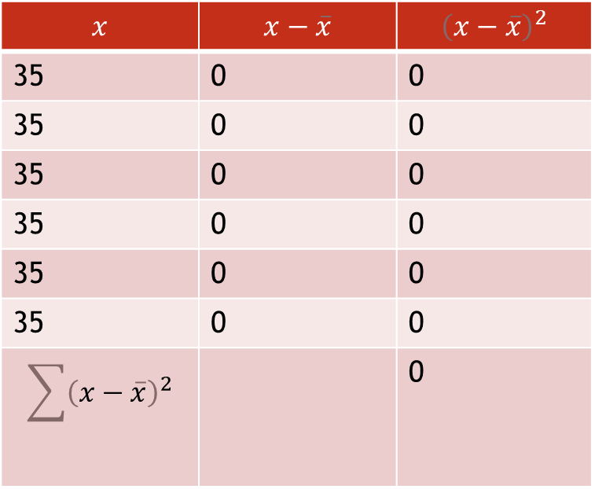
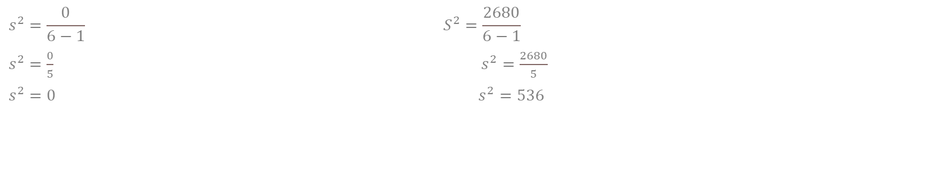
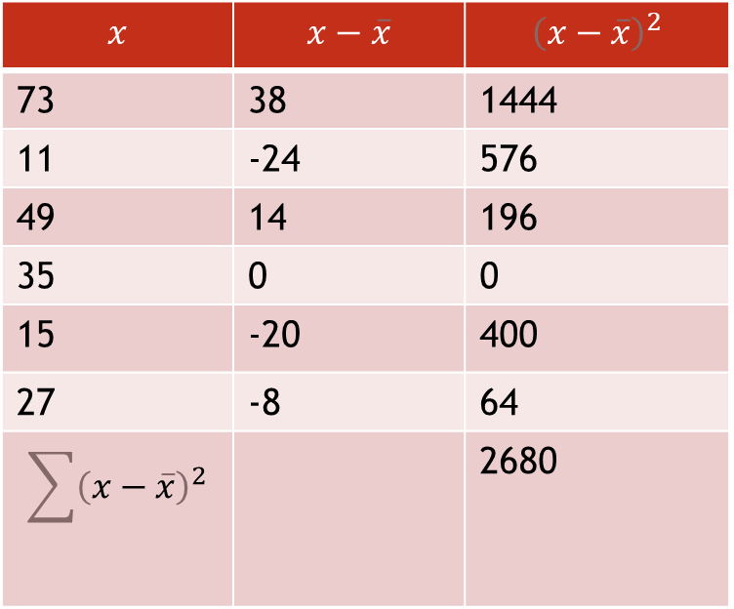
$$x$$ | $$x−\overline{x}$$ | $${\left(x−\overline{x}\right)}^{2}$$
35 | 0 | 0
35 | 0 | 0
35 | 0 | 0
35 | 0 | 0
35 | 0 | 0
35 | 0 | 0
$$\sum{{\left(x−\overline{x}\right)}^{2}}$$ |  | 0
$$x$$ | $$x−\overline{x}$$ | $${\left(x−\overline{x}\right)}^{2}$$
73 | 38 | 1444
11 | -24 | 576
49 | 14 | 196
35 | 0 | 0
15 | -20 | 400
27 | -8 | 64
$$\sum{{\left(x−\overline{x}\right)}^{2}}$$ |  | 2680
$$s^{2}=\frac{0}{6−1} S^{2}=\frac{2680}{6−1}$$
$s^{2}=\frac{0}{5}$ $s^{2}=\frac{2680}{5}$
$s^{2}=0$ $s^{2}=536$

Slide 8
Conclusion:
Variance is great to compare two or more sets of data from different populations. In case, the sample estimates the variance for the Data set1> Data set2, then we can say that the population1 has more variability in its data than the population2.
Variance analysis is essential for the appraisal of all aspects of the business, including manufacturing, marketing and services.

Slide 9
REFERENCES:
https://www.powershow.com
https://slideplayer.com
https://faculty.msmc.edu

Slide 10
thankyou

