Slide 1
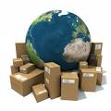
A PRESENTATION ON WHOLESALING
Associate Professor & Head
School of Management
Gangadhar Meher University

Slide 2
CONTENTS
INTRODUCTION
TYPES OF WHOLESALING
IMPORTANCE
FUNCTION
STRATEGIC MANAGEMENT OF WHOLESALING

Slide 3
INTRODUCTION
INTRODUCTION
Wholesaling is concerned with the activities of those persons or establishments which sell to retailers and other merchants, and or to industrial, institutional and commercial users, who do not sell insignificant amounts to ultimate consumers.
Wholesaling often occurs when large quantities of merchandise are reassembled, sorted, then repackage, and distribute in smaller lots.
In banking, the term wholesaling refers to services that are designed for large, institutional clients, including real estate developers, pension funds and large corporations, as opposed to retail banking which provides services to standard, individual customers.

Slide 4
Cont…
Wholesaling is one step on the supply chain, which includes various companies like suppliers, manufacturers and retailers. Retailers and other users purchase goods from wholesalers, and then sell the products at a higher price to cover costs and generate profits. Supply chain management (SCM) was developed in the 1980s to address the need to maximize efficiency in the business processes involved in moving goods from original suppliers to end users.

Slide 5
Types of wholesaling
There are 3 types of wholesaling. They are as follows;
Merchant wholesaling
Agent wholesaling
Manufacturers’ sales branches and offices
MERCHANT WHOLESALING:
Merchant wholesaling take ownership of goods in which they deal: they are independently owned, separate from suppliers on the one hand from the retailers on the other hand. The distinguishing feature of merchant wholesaling is that take ownership and associated risks related to the goods traded.

Slide 6
Cont…
Merchant wholesaling are of two general classes: full function or service wholesaling and limited function wholesaling.
Full function or service wholesaling: This type of wholesaling is also referred to as a distributor or a jobber. These are specialize in a narrow range of goods. It maintain inventories of their product line. It also participate in most aspects of the marketing channel flow.
Limited function wholesaling: These merchant wholesaling perform only some of the functions typically associated with wholesaling.

Slide 7
AGENT WHOLESALING
Unlike merchant wholesaling , agent wholesaling do not take ownership and rarely take possession of the products that they market. They are primarily involved in the buying and selling of goods and services. They typically negotiate sales as representative of others firms and do not take title to merchandise. They also participate in the collection of market information, promotion, and ordering. Agent receive a commission for performing these functions. Among different types of agents are manufacturers agents, brokers, commission merchants, selling agents and auction companies. They also play an integral role in international trade.

Slide 8
Manufacturer’s sales branches and sales offices
These are wholesaling operations owned and operated by a manufacturer and maintained separately from the producing plant to sell and market its products. The sales branches include a warehouse with inventory, whereas sales offices do not have any inventory. Manufacturers’ branch stores selling to consumers and individual users are classified within retail trade. These are also, sometimes, called, captive distributors.
Manufacturers use sales branches and offices for a variety of reasons, they are;

Slide 9
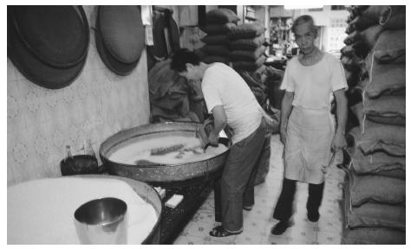
Cont…
Independent wholesaling are unable to provide the technical support to the consumer.
These intermediaries cannot handle the quantities involved.
The manufacturers wishes to achieve more control over the promotion and physical possession activities of marketing.
The wholesaling operations provide the manufacturer with additional profit opportunities.

Slide 10
Importance of wholesaling
Wholesale businesses is one of the most important part of many business processes, particularly for the distribution of stocks and products to other businesses such as retailers and other wholesalers.
According to many business experts, wholesale businesses such as a wholesale clothing business is an integral part of the distribution process because it allowed for manufacturers and retailers to deal with each other.
Importance of wholesaling However, there are several advantages to dealing with wholesalers and distributors that the Internet haven’t taken over.

Slide 11
Functions of wholesaling
There are three major functions. They focus on creating utility.
Time utility:
When products and services are available for sale when the consumer wants to purchase them.
Place utility:
When goods and services are convenient location.
Ownership/possession utility:
When title to the products passes from the producer or intermediary to the purchaser.

Slide 12
Strategic management of wholesaling
The success of a wholesaling firm depends upon the following major factors:
1.EFFECTIVENESS: Effectiveness of a wholesaling depends upon:
Identifying target market needs,
Developing a product and service mix to satisfy those needs and
Adjusting the product and service mix to meet changes in the target market needs. Understanding target market needs is the main criterion for the success of any marketing institution. Without a clear understanding of the product requirements of the target market, wholesaler would have no idea how best to approach their customers or how to maintain long-term supplier-customer relationships with them.

Slide 13
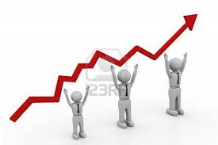
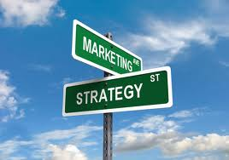
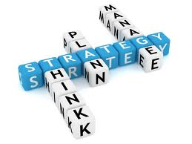
Cont…
2.PROFITABILITY: Profitability of a wholesaling is mainly based on two factors
Managing net profit margins, and
Achieving high rates of assets turnover.
3. NICHE MARKETING:
Several wholesaling owe their success to niche market strategy that specializes in limited or unique product categories
4.PROPRIETORY BRANDS:
Generally, successful wholesaling have developed strong proprietary brand products for gaining and maintaining a sustained competitive advantage.

Slide 14
Cont…
5.NEW TECHNOLOGY:
Mechanization and automation of warehouses strengthens relations with both customers and suppliers. Computer linkage among distribution channels is becoming a prerequisite for success in wholesale trade. Therefore, new technology adoption has deep significance in the wholesaling business.

Slide 15
Thank you

