Slide 1
VOLPONE
BEN JONSON
Presented by:
Jaspal Kaur Matharu
Guest Faculty
Department of English
Gangadhar Meher University

Slide 2
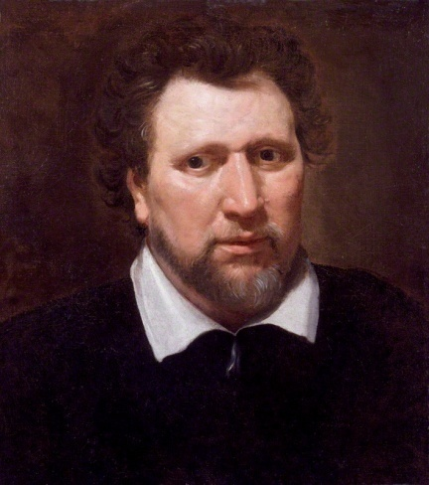
Ben Jonson
Benjamin “Ben” Jonson (11 June 1572- 16 August 1637) was an English playwright and poet. He popularised the Comedy of Humours. He was influencial because of English Poetry and Stage Comedy .
Famous Works:
Every Man In His Humour (1598)
Volpone, or The Fox (1607)
The Alchemist (1610)
Bartholomew Fair (1614)

Slide 3
Volpone,
or
The Fox
Volpone, in full Volpone; or, The Fox, is a Comedy in five acts by Ben Jonson, performed about 1605 or 1606 and published in 1607, drawing on elements of city comedy and beast fable. A satire about greed and lust. It remains Jonson's most-performed play, during Jacobean Era. The play is set in Venice.
Comedy of Humours:
A type of comedy developed by Ben Jonson based on the ancient physiological theory of the “Four Humours” that was still current in Jonson’s time. The humours were held to be the four primary fluids- blood, phlegm, choler (or yellow bile), and melancholy (or black bile)- whose “temperament”(mixture) was held to determine both a person’s physical condition and type of character.

Slide 4
Characters
Volpone (the Sly Fox)
Mosca (the Fly)
Voltore (the Vulture)
Corbaccio (the Raven)
Bonario
Corvino (the Carrion Crow)
Celia
Sir Politic Would-Be
Lady Would-Be (the parrot)
Peregrine ("Pilgrim")
Nano
Androgyno
Castrone
The Avocatori

Slide 5
Plot
Act 1
The play opens with Volpone and his servant, Mosca, discussing Volpone's fortune. For the past few months, Volpone has been tricking his greedy business partners, called legacy-hunters, into thinking he will die soon. Without a wife or child to inherit Volpone's estate, the three wealthy businessmen, Voltore, Corbaccio, and Corvino, visit Volpone's sickbed with lavish gifts, each one convinced he will be named Volpone's heir. Mosca convinces Corbaccio to disinherit his own son, naming Volpone his heir, in the hopes Volpone will return the favour.
Act 2
When Mosca makes an off-hand comment about the beauty of Corvino's wife, Celia, whom he keeps locked in a tower, Volpone desires to see her. Dressed as a travelling medicine man, Volpone delivers a lengthy speech about his powerful elixir beneath Celia's window. She drops her handkerchief, which signals she would like to make a purchase. This infuriates Corvino, and he threatens to kill her. Back home, Volpone claims to be in love with Celia and wants nothing more than to sleep with her. Mosca convinces Corvino sleeping with Celia would restore Volpone's health and ensure he be named heir.

Slide 6
Act 3
Ignoring Celia's adamant refusal, Corvino drags his wife to Volpone's bed and threatens to kill her if she refuses to sleep with him. At the same time, Corbaccio's son Bonario arrives, demanding to know why he has been disinherited. Mosca tells him to hide in the cupboard until his father arrives, during which time everything will be made clear. Volpone attempts to seduce Celia into his bed, but when she refuses, he tries to rape her. Bonario intercedes, saving Celia and discovering Volpone's virile health.
Act 4
At the courthouse, Voltore gives an impassioned speech claiming Bonario and Celia were having an affair and plotted to steal Volpone's fortune. The court finds Bonario and Celia guilty, while Volpone and the legacy-hunters are released.

Slide 7
Act 5
Rather than appreciate his narrow escape from prison, Volpone concocts a new plan, in which he fakes his death and, in disguise, watches the legacy-hunters' shocked reactions upon learning that Mosca has been named heir. Mosca delivers the news, and a disguised Volpone delights in harassing and goading the devastated legacy-hunters.
Everyone reassembles at the courthouse to hear Bonario and Celia's sentence. Overwhelmed by guilt and disappointment, Voltore attempts to tell the court the truth, but a still-disguised Volpone tells him Volpone is still alive. The faked death, he claims, was a test of Voltore's loyalty. Panicked that he might lose his chance of being named Volpone's heir, Voltore collapses to the ground and pretends to be possessed. Mosca, sensing an opportunity to claim Volpone's fortune as his own, continues the ruse that he has been named heir. Suddenly realizing he might lose everything, Volpone removes his disguise and tells the court the truth. They strip Volpone, Corbaccio, Corvino, and Voltore of their fortunes in addition to other harsh punishments. Bonario and Celia are set free, and Mosca is imprisoned and sent to the galleys.

Slide 8
Themes
Greed and Corruption
Appearance versus Reality
Money
Gender Roles and Women
Animal Fable

Slide 9
Critical View
Volpone brilliantly exemplifies Jonson’s unique jungle vision, with its self-contained world composed entirely of predators and prey. His contempt for mercenary motivation and capitalistic enterprise is blistering; the commanding indictment of the vicious habits of the new acquisitive society shows Jonson’s forward leap in terms of intellectual and analytical maturity. The play demonstrates throughout Jonson’s new-found ability to use the grim stuff of human wickedness and weakness, material not of a comic nature in itself, as the basis of satiric comedy. Obsessional greed, lust, the savage disregard of all other human beings and even eventually of personal survival—these are hardly funny, but Jonson makes them so. Yet never does he diminish the power of his portrayal of these ruthless materialists who embody “Appetite, the universal wolf.”
—Rosalind Miles, Ben Jonson: His Craft and Art

