Slide 1

PRESENTATION ON:
INDUSTRIAL POLICY 1991
Dr. Srinibash Dash
Associate Professor & Head
School of Management
GMU, SBP

Slide 2
SYNOPSIS
MEANING OF INDUSTRIAL POLICY
OBJECTIVE OF INDUSTRIAL POLICY
OBJECTIVE OF NEW INDUSTRIAL POLICY
FEATURES OF NEW INDUSTRIAL POLICY
INDUSTRIAL POLICY
POSITIVE & WATCH OUT

Slide 3
MEANING :INDUSTRIAL POLICY
INDUSTRIAL POLICY MEANS RULES,REGULATIONS, PRINCIPLES,
POLICIES,AND PROCEDURES LAID DOWN BY GOVERNMENT FOR REGULATING DEVELOPING AND CONTROLLING INDUSTRIAL
UNDERTAKINGS IN THE COUNTRY .IT PRESCRIBES THE RESPECTIVE
ROLES OF THE PUBLIC,PRIVATE JOINT AND COOPERATIVE
FOR THE DEVELOPMENT OF INDUSTRIES .IT ALSO INDICATES THE
ROLES OF THE LARGE ,MEDIUM, AND SMALL SECTORS. IT
INCORPORATES FISCAL AND MONETARY POLICIES, TARIFF
POLICY,LABOUR POLICY AND THE GOVERNMENT ATTITUDE
TOWARDS FOREIGN CAPITAL AND ROLE TO BE PLAYED BY MNCS
IN THE DEVELOPMENT OF THE INDUSTRIAL SECTORS.

Slide 4
FEATURES OF NEW INDUSTRIAL POLICY :
DE-RESERVATION OF PUBLIC SECTOR:
1. THE NO. OF INDUSTRIES RESERVED FOR PUBLIC SECTOR WAS
REDUCED TO INDUSTRIES .AT PRESENT ,THERE ARE ONLY 3 INDUSTRIES RESERVED FOR
PUBLIC SECTOR WHICH INCLUDE:- ATOMIC ENERGY ,RAILWAYS , SPECIFIED MINERALS.
2. DE-LICENSING:
THE MOST IMPORTANT FEATURES OF NIP, 1991 WAS THE ABOLITION OF INDUSTRIAL
LICENSING OF ALL INDUSTRIES EXCEPT 6 INDUSTRIES .THE 6 INDUSTRIES ARE OF
social and strategic concern.
3.DISINVESTMENT OF THE PUBLIC SECTOR:
NIP 1991 PERMITTED DISINVESTMENT OF PUBLIC SECTOR UNITS. DISINVESTMENT
IS A PROCESS OF SELLING GOVERNMENT EQUITY IN PSUs IN FAVOUR OF PRIVATE PARTIES.
4. FOREIGN INVESTMENT:
APPROVAL WILL BE GIVEN FOR DIRECT FOREIGN INVESTMENT UPTO 5 1% FOREIGN
EQUITY IN HIGH PRIORITY INDUSTRIES .THERE SHALL BE NO BOTTLENECKS OF ANY
KIND IN THIS PROCESS.

Slide 5
FEATURE CONTINUES……..
MRTP ACT:
EMPHASIS WILL BE PLACED ON CONTROLLING AND REGULATING MONOPOLISTIC , RESTRICTED AND UNFAIR TRADE PRACTICES. SIMULTANEOUSLY , THE NEWLY EMPOWERD MRTP COMMISSION WILL BE AUTHORISED TO INITIATIVE INVESTIGATION.
FREE ENTRY TO FOREIGN INVESTMENT & TECHNOLOGY:
THE GOVERNMENT IS COMMITTED TO PROMOTE INCREASED FLOW OF FOREIGN DIRECT INVESTMENT FOR BETTER TECHNOLOGY , MODERISATION , PROVIDING PRODUCT AND SERVICES OF INTERNATIONAL STANDARDS.

Slide 6
OBJECTIVES OF INDUSTRIAL POLICY
TO MAINTAIN A SUSTAINED GROWTH IN PRODUCTIVITY.
TO ENHANCE GAINFUL EMPLOYMENT.
TO PREVENT UNDUE CONCENTRATION OF ECONOMIC POWER.
TO ATTAIN INTERNATIONAL COMPETITIVENESS AND TRANSFORM INDIA INTO A MAJOR PARTNER AND PLAYER IN THE GLOBAL ARENA.
LIBERALISING THE INDUSTRY FROM THE REGULATORY DEVICES SUCH AS LICENSES AND CONTROLS.
ABOLITION OF INDUSTRIAL LICENSING.
DE- RESERVATION OF INDUSTRIES FOR PUBLIC SECTOR.
DISINVESTMENT IN SELECTED PUBLIC SECTOR INDUSTRIAL UNITS.

Slide 7
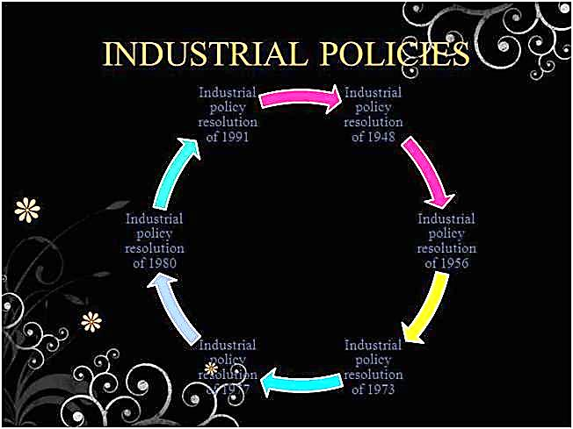

Slide 8
POSITIVES & WATCH-OUT:
POSITIVES:
DE-LICENSING OF MOST INDUSTRIES WILL HELP ENTREPRENEURS TO QUICKLY SEIZE BUSINESS OPPORTUNITIES.
REMOVAL OF CONTROLS UNDER THE MRTP ACT WILL FACILITATE EXPANSION AND GROWTH.
THERE WILL BE GREATER INFLOW OF FOREIGN CAPITAL AND TECHNOLOGY DUE TO EASING OF RESTRICTIONS .
BURDEN ON THE P[UBLIC SECTOR WILL BE REDUCED..
WATCH-OUT:
THE BUREAUCRACY HAS A TENDENCY TO ATTEMPT TO DEFEAT MEASURES AIMED AT DE-REGULATION.
FOREIGN INVESTORS STILL REGARD THE POLICY AND PROCEDURAL SYSTEM IN INDIA CONFUSING.

Slide 9
WATCH- OUT CONTINUES………..
RATHER MANY FEEL THAT POLICY AND DEVELOPMENT IN CHINA IS SUPERIOR TO INDIA.
DISTORTION IN INDUSTRIAL PATTERN WOULD OCCUR DUE TO SLOW PACE OF INVESTMENT IN FEW BASIC & STRATEGIC INDUSTRIES . ABSENCE OF A MECHANISM WOULD SLOW DOWN THE DEVELOPMENT OF BACKWARD AREAS .

Slide 10

THANK YOU…….
FOR YOUR PATIENT HEARING………

