Slide 1
MULTINATIONAL CORPORATION
Dr. Srinibash Dash
Associate Professor & Head
School of Management
GMU, SBP

Slide 2
WHAT IS THE MULTINATIONAL CORPORATION?
MNC’s are huge industrial organizations which extend their industrial and marketing operations through a network of their branches or their Majority Owned Foreign Affiliates.
MNC’s is a large corporation which produces or sells goods in various countries.
MNC’s are also know as Transnational Corporation (TNC’s).

Slide 3
DEFINITION
According to the Industrial Labour Organizations “The essential nature of the multinational enterprises lies in the fact that its managerial headquarters are located in one country, while the enterprise carries out operations in a number of other countries as well”.

Slide 4
HISTORY & Evolution of mnc
These corporations originated early in the 20th century and expanded after World War II.
The British east India company, Hudson’s bay corporation and Royal Africa companies are example of MNCs.
The Dutch East India Company was the first multinational corporation in the world and the first company to issue stock.

Slide 5
HISTORY & Evolution of mnc
Almost all the earliest and largest multinational firms were either American, Japanese, or West European.
A multinational corporation developed new products in its native country and manufactured them abroad.

Slide 6
OBJECTIVES OF MNC
To expand the business beyond the boundaries of the home country.
Minimize cost of production, especially labour cost.
Achieve greater efficiency by producing in local market and then exporting the products.
Make best use of technological advantages by setting up production facilities abroad.

Slide 7
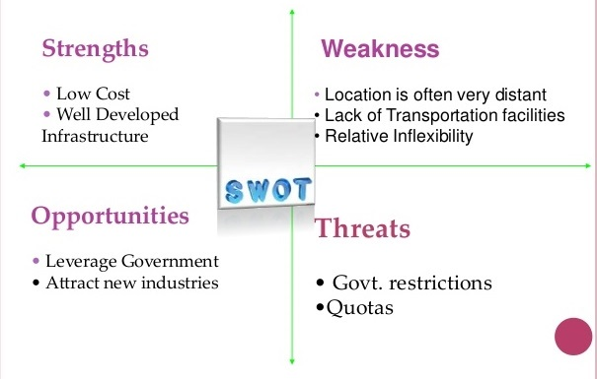
SWOT ANALYSIS OF MNC’S

Slide 8
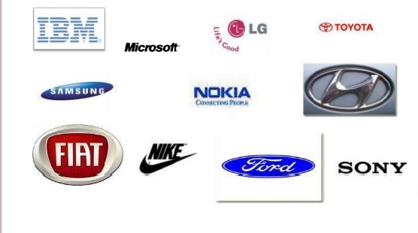
EXAMPLES OF MNC

Slide 9
REASONS FOR THE ESTABLISHMENT OF MNCS
To increase market share.
To secure cheaper premises and labour.
To avoid or minimise the amount of tax to be paid.
To save on costs of transporting goods to the market place.
To develop an international brand.
To take advantage of government grants available.

Slide 10
ADVANTAGES OF MNC
It have became vehicle of technology to the developing countries .
Greater employment and career opportunities are provided by the multinational companies.
Variety of goods and services produced for local customers .
Multinational companies make commendable contribution to invention in the host country .

Slide 11
DISADVANTAGES OF MNC
MNCS create monopolies in the market and eliminate local customers.
MNC’S generally import huge raw materials due to its continuous use by these overseas companies.
The problem of dumping example – Chinese low quality products in Indian Market.

Slide 12
SOME OF THE EXAMPLES OF MNC
ARE

Slide 13
BPL
BPL is an Indian electronics company. Its stands for "british physical laboratories".
It deals with consumer electronics (such as refrigerators and washing machines), mobile networks etc
The company was started at a time when the government had reserved many areas of business for the public sector .
BPL's growth has been subject to constant challenges using its experience of the market and the consumer, BPL concentrated on importing technology, improving product quality, innovations and manufacture of electronic products that enhanced the quality of life.

Slide 14
ONIDA
Onida, a leading television brand, is still well known for its brand mascot ‘the onida devil’ and its punch line “neighbor's envy owner’s pride”.
Onida launched its advertising campaign in the 1980s when owning a television set was considered a luxury.
The mascot helped onida gain substantial market share and brand recall among the customers and become one of the top three television brands in the country.

Slide 15
SAMSUNG
Samsung India is the hub for Samsung's south west Asia regional operations.
Samsung’s uses state of the art highly automated manufacturing facilities.
Samsung has been awarded as the best retailer of the year 2005.
Samsung India commences exports of 'made in India' colour televisions to western Europe second production line set up at Noida for the manufacture of projection TVs in India .

Slide 16
LG
LG life’s good electronics India Pvt. Ltd., A wholly owned subsidiary of LG electronics, south Korea was established in January, 1997.
LG has been able to craft out in eight years, a premium brand positioning in the Indian market and is today the most preferred brand in the segment.
In 2003, lg has emerged as the leader in colour televisions, semi automatic washing machines, air conditioners, frost-free refrigerators and microwaves ovens.
Lg is the no one brand in the market.

Slide 17
CONCLUSION
To conclude, we would opine that MNC’s exists lots of job opportunity paves a path for the increase in National Income and also to create a better society,
with better standard of living, and it increases labour productivity and decrease in unemployment.
This will help the government and this will lead to increase in the export and imports in the country.

Slide 18


