Slide 1


Larsen Toubro
&
DR. SRINIBASH DASH
Associate professor & Head
School of Management
SBP,GMU

Slide 2

CORPORATE PROFILE
Larsen & Toubro (L&T) is a technology, engineering, construction and manufacturing company. It is one of the largest and most respected companies in India's private sector. L&T has an international presence, with a global spread of offices. This company was founded in Mumbai in 1938 by two Danish engineers, Henning Holck-Larsen and Soren Kristian Toubro. The company began as a representative of Danish manufacturers of dairy equipment. However, with the start of the Second World War in 1939 and the resulting restriction on imports, the partners started a small workshop to undertake jobs and provide service facilities.
Germany's invasion of Denmark in 1940 stopped supplies of Danish products. The war-time need to repair and refit ships offered L&T an opportunity, and led to the formation of a new company, Hilda Ltd., to handle these operations. L&T also started to repair and fabrication shops signaling the expansion of the company.
In 1945, the company signed an agreement with Caterpillar Tractor Company, USA, for marketing earth moving equipment. At the end of the war, large numbers of war-surplus Caterpillar equipment were available at attractive prices, but the finances required were beyond the capacity of the partners. This prompted them to raise additional equity capital, and on 7 February 1946, Larsen & Toubro Private Limited was born.

Slide 3
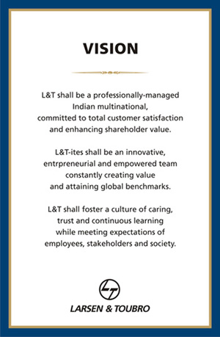
VISION
L&T shall be a professionally-managed Indian multinational, committed to total customer satisfaction and enhancing shareholder value.
L&T-ites shall be an innovative, entrepreneurial and empowered team constantly creating value and attaining global benchmarks.
L&T shall foster a culture of caring, trust and continuous learning while meeting expectations of employees, stakeholders and society.

Slide 4
MISSION
L&T shall provide products based on efficient and environment-friendly technology, consistently surpassing customer expectations of quality and on-time delivery.
L&T shall follow fair and transparent practices with all stakeholders and achieve performance excellence by innovation and continuous improvements in people, products and services.
L&T shall foster a culture of care, trust, challenge and empowerment among its employees.

Slide 5
Objectives
Provide a high quality and relevant education in project management for all L&T employees and prepare them to be proficient as contributing members of project teams and also as excellent project managers.
Collate and disseminate the body of knowledge in project management as practiced in Larsen & Toubro - L&T Body of Knowledge (L&T BOK) through structured courses in project management.
Develop and deliver project management cases from projects undertaken by L&T.
Benchmark global project management practices and incorporate these practices in the curriculum thereby creating a centre of excellence in project management.
Collaborate with leading institutes of repute across the globe for research in project management for enhancing excellence in project management.
Create a unique body of knowledge - L&T BOK - and document in archival publications and textbooks.or the organisation.

Slide 6
SWOT ANALYSIS
STRENGTH | OPPORTUNITY
1. Diversified revenue stream 2. Strong customer base 3. Global presence 4. Strong financial performance, revenue of US $ 650 million and employee strength of 15,000. | 1. Emerging markets 2. Emerging Cloud computing technology
WEAKNESS | THREAT
1. Dependence on mature market 2. High customer concentration | 1. High exposure to the foreign markets 2. Bigger MNC's entering India and competing for global clients 3. Economic slowdown and uncertainty in USA and Europe respectively

Slide 7
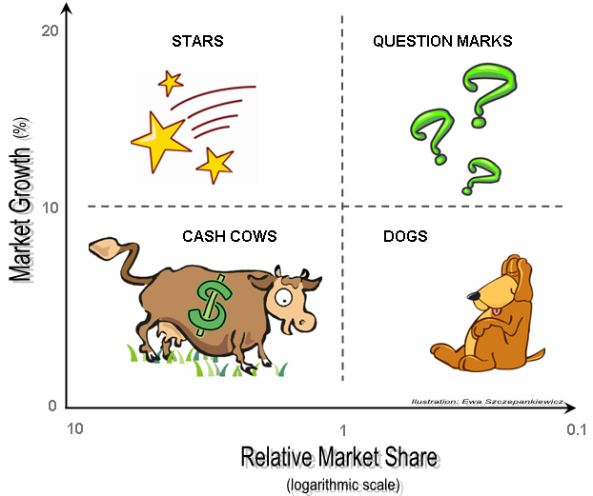
BCG MATRIX
Market Growth Rate of Larsen & Toubro 22.4% and it is leading in its overall business.
Relative market Share of Larsen & Toubro is 7.4%.
Larsen
&
Toubro

Slide 8


