Slide 1
INDUSTRIAL POLICY OF INDIA
Dr. Srinibash Dash
Associate Professor & Head
School of Management
GMU, SBP

Slide 2
Contents:
Industrial Policy
Types of Industrial Policy Resolutions
Features of Industrial Policy Resolutions 1948-1980
New Industrial Policy 1991
Conclusion

Slide 3
Industrial policy:
The policies of a nation that help guide the total strategic effort of the country. The policies influence the development of different sectors and create a stronger portfolio of national industry.
Industrial policies are sector specific, unlike broader macroeconomic policies. They are often considered to be interventionist as opposed to laissez-faire economics
Contd..

Slide 4
Contd..
It refers to the Govt. policy towards the establishment working and management and industries in the country.
It covering all those principles, procedures and regulations which control the industrial understandings of the country.
It reflects the Government’s attitude the public and private sectors, foreign capital and technology etc.
It shape the pattern of industrialism in the country.
It is helpful in the development of industries as per the needs of the country.

Slide 5
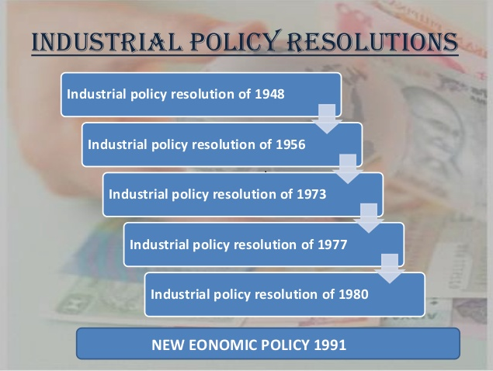
Industrial Policy Resolutions:

Slide 6
Industrial policy resolution of 1948
Acceptance of the both public and private sectors were involved towards industrial development.
Division of Industrial Sector:
  Exclusive State Monopoly- exclusive monopoly of the Central Government(railway transport, atomic energy etc.).
  State Monopoly for New Units- undertaken only by the State(coal, iron, steel, wireless, telegraphs etc.).
  State Regulation- which the Central Gov­ernment would feel necessary to plan and regulate(machine tools, fertilizers, cement, paper, electric engineering etc.).
  Unregulated private enterprise- the in­dustries in this category were left open to the private sector, individual as well as cooperative.

Slide 7
Industrial policy resolution of 1956
To accelerate the rate of growth and to speed of industrialization.
According to this Resolution the objective of the social and economic policy in India was the establishment of a socialistic pattern of society.
  Schedule A- those industries which were to be an exclusive responsibility of the state.
  Schedule B- those which were to be progressively state-owned and in which the state would generally set up new enterprises.
  Schedule C- all the remaining industries and their future development would, in general be left to the initiative and enterprise of the private sector.

Slide 8
Silent features of Industrial policy 1956
Division of work:
  Monopoly of the state
  Mixed sector of public and private enterprise
  Industries left for private sector
Mutual dependence of public and private sector
Importance given to small and cartage industries
Deductions of erosional in equalities.
Assistance and control of private sector.

Slide 9
Industrial policy resolution of 1973
It provided for a closer interaction between the agricultural and industrial sectors.
The list of industries exclusively reserved for the small sector increased from 150 items to 500 items.
Special legislation to protect cottage and household industries was also introduced.

Slide 10
Industrial policy resolution of 1977
The government would promote the development of a system of linkages between nucleus plants and satellite ancillaries
To boost the development of small scale industries, enhanced the investment limit of units.

Slide 11
Industrial policy resolution of 1980
Correction of regional imbalances
Maximum production and achieving higher productivity
Higher employment generation.
Promotion of export –oriented industries and strengthening of the agricultural base
Consumer protection against high prices and bad quality
Promotion of economic federalism through equitable spread of investment and dispersal of returns.

Slide 12
New Industrial policy 1991
The objectives of the new industrial policy are build on the gains for previous policies.
Major changes
Industrial Licensing
Foreign Investment
Foreign Technology Agreements
Public Sector Policy
MRTP Act
Other Liberalization

Slide 13
Conclusion:
In many ways, theories of industrialization have come full circle. Moreover, the challenge facing the more developed countries – making the existing industrial infrastructure more competitive, or upgrading technological capabilities – requires different approaches to that of kick-starting industrialization.

Slide 14
Thank You

