Slide 1
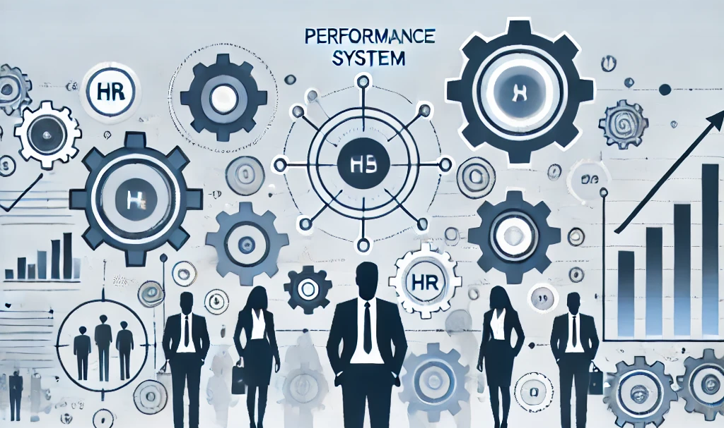
HR Performance Management System
by
Dr. Srinibash Dash
Associate Professor & Head
School of Management
Gangadhar Meher University

Slide 2
CONTENTS
Introduction
Importance
Steps of HR PMS
Methods of HR PMS
Challenges
Case study
Conclusion

Slide 3

What is HR Performance Management System?
A performance Management system (PMS) in HR is a structured framework designed to aligns employee performance with organizational goals through goal setting, feedback, evolution and development

Slide 4
Importance of HR Performance Management System:
Aligns Goals: Ensures employee objectives align with organizational strategy.
Enhances Productivity: Boosts individual and team performance through regular feedback.
Promotes Growth: Facilitates employee learning and career development.
Fair Evaluation: Provides a structured approach to measure and reward performance.
Improves Retention: Encourages engagement and reduces turnover by recognizing contributions.

Slide 5
Steps for HR Performance Management System
Goal Setting: Define clear, measurable objectives aligned with organizational goals.
Monitoring: Track progress and provide ongoing feedback.
Evaluation: Assess performance through appraisals and reviews.
Development: Create plans for skill-building and growth.
Rewarding: Recognize and reward achievements to motivate employees.

Slide 6
Methods of HR Performance Management System
360-Degree Feedback: Collect feedback from peers, managers, and subordinates.
Self-Assessment: Employees evaluate their own performance.
Management by Objectives (MBO): Measure performance against specific goals.
Behaviorally Anchored Rating Scales (BARS): Assess behaviors linked to performance.
Ranking Method: Rank employees based on their performance relative to others.

Slide 7
Challenges in HR Performance Management System
Bias in Evaluations: Subjective judgments can lead to unfair assessments.
Resistance to Feedback: Employees or managers may avoid or dismiss constructive feedback.
Lack of Clear Goals: Undefined or misaligned objectives hinder effective performance tracking.
Ineffective Communication: Poor dialogue between employees and managers reduces engagement.
Time-Consuming Processes: Complex or outdated systems can burden HR and managers.

Slide 8
Case Study: Human Resource Performance Management System
This case study examines the implementation of a Human Resource Performance Management System (PMS) in a mid-sized organization. The focus is on identifying the challenges faced in managing employee performance, the steps taken to implement an effective system, and the resulting outcomes. The study emphasizes how PMS can enhance employee productivity, engagement, and organizational success.
Company Profile
Name: TechNova Inc.
Industry: IT services
Employees: 700
Locations: Offices in North America, Europe, and Asia.

Slide 9
Key Issue: Lack of a formal performance management process led to inconsistent performance reviews, low employee motivation, and poor organizational alignment.
Solution: Implementation of a Performance Management System TechNova Inc. adopted a modern Performance Management System that aimed to create a structured, transparent, and data-driven approach to managing employee performance.
Steps Taken
Identifying Objectives : Align individual and team goals with the organization's strategic objectives . Make the process fair, transparent, and collaborative.
Selecting the Right PMS Tool : Adopted a cloud-based PMS platform with features like real-time feedback, goal tracking, and analytics.
Introducing SMART Goals : Employees and managers worked together to set Specific, Measurable, Achievable, Relevant, and Time-bound (SMART) goals.
360-Degree Feedback Mechanism : Incorporated feedback from peers, managers, subordinates, and self-assessments to ensure well-rounded evaluations.
Continuous Performance Reviews : Shifted from annual appraisals to continuous feedback and quarterly performance check-ins.
Employee Development Plans : Focused on career growth by offering training programs, mentoring, and coaching.
Training Managers and Employees : Provided workshops to familiarize everyone with the new system and encourage its adoption.

Slide 10
Results Achieved
Increased Employee Engagement
Improved Goal Clarity
Fair and Transparent Process
Enhanced Productivity
Data-Driven Decisions
Conclusion: The implementation of a modern Performance Management System transformed TechNova Inc.'s approach to employee performance. By fostering transparency, fairness, and continuous development, the organization improved productivity, employee satisfaction, and overall business outcomes. This case study highlights the critical role of HR technology in driving organizational success.

Slide 11
Conclusion
An effective HR Performance Management System aligns individual goals with organizational objectives, enhances productivity, promotes employee growth, and ensures fair evaluations. By fostering continuous feedback and development, PMS drives both employee engagement and organizational success.

Slide 12
Thank you

