Slide 1
Ghosts
Henrik Ibsen
Presented by:
Jaspal Kaur Matharu
Guest Faculty
Department of English
Gangadhar Meher University

Slide 2
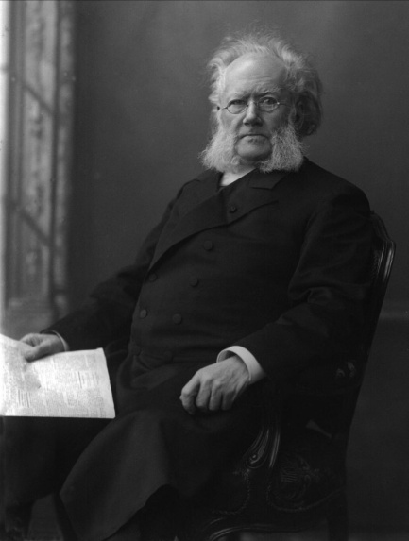
Henrik Ibsen
Henrik Ibsen, in full Henrik Johan Ibsen, (born March 20, 1828, Skien, Norway—died May 23, 1906,Kristiania), major Norwegian playwright of the late 19th century who introduced to the European stage a new order of moral analysis that was placed against a severely realistic middle-class background and developed with economy of action, penetrating dialogue, and rigorous thought.
Famous Works:
A Doll’s House(1879)
Ghosts(1881)
The Wild Duck(1884)
Hedda Gabler(1890)

Slide 3

Ghosts
Ghosts, a drama in three acts by Henrik Ibsen, published in 1881 in Norwegian as Gengangere and performed the following year. The play is an attack on conventional morality and on the results of hypocrisy.
Ostensibly a discussion of congenital venereal disease, Ghosts also deals with the power of ingrained moral contamination to undermine the most determined idealism. Although the lecherous Captain Alving is in his grave, his ghost will not be laid to rest. The memorial that Helen, his conventionally minded widow, has erected to his memory burns down even as his son Oswald goes insane from inherited syphilis and his illegitimate daughter slips inexorably toward her destiny in a brothel.

Slide 4
Characters
Mrs. Helen Alving
Oswald Alving
Pastor Manders
Jacob Engstrand
Regina Engstrand

Slide 5
Plot
Ghosts begins on a rainy day in a remote part of Norway on the estate of Mrs. Helene Alving, a widow of some fortune. The household is preparing for the opening of an orphanage built by Mrs. Alving in honor of her late husband, Captain Alving. Regina Engstrand, Mrs. Alving's maid, has a strained conversation with her father, Engstrand, a carpenter with negative attitudes and a malformed leg that causes him to hobble. They argue about her future and her role in his shady business plan for a sailors' hotel that will be nothing more than a house of prostitution.
As Regina shoos her father away, Pastor Manders arrives. A longtime family friend, Pastor Manders handles business transactions related to the orphanage, and he has come to review final details with Mrs. Alving. But before he and Mrs. Alving conduct their meeting, he chastises her for reading books he sees that he considers inappropriate. She informs him that her reading mirrors what she has often thought and what most people believe. But, she says, "most people don't like to face these things, or what they imply." Pastor Manders considers this position of hers on free love and progressive behavior immoral.

Slide 6
Their conversation widens to include Mrs. Alving's son, Osvald Alving, who is ill and has now returned from Europe to attend the opening of the orphanage. Osvald is an artist, and Pastor Manders is again scandalized when Osvald describes his friends, whose lifestyle Pastor Manders rejects: "But you're talking about illicit relations! About plain, irresponsible free love!" the pastor exclaims. Osvald politely tells the pastor he disagrees with his moral outrage, because his friends are good people.
Mrs. Alving and Pastor Manders continue the conversation alone. She reveals details about her relationship with her late husband that come as a surprise to her friend. Captain Alving's affairs and drinking and Mrs. Alving's disgust with her marriage shock Pastor Manders. Osvald is overheard making inappropriate advances toward Regina, and Pastor Manders and Mrs. Alving fear the past is repeating itself from father to son.
As the story unfolds, Mrs. Alving tells Pastor Manders more about her marriage and the lies she has constructed to preserve Captain Alving's reputation. Among other sordid details, she reveals Regina is Captain Alving's illegitimate child. Pastor Manders now better understands Mrs. Alving's desire to leave her husband early in her marriage, although based on Pastor Manders's faith, he thinks it was Mrs. Alving's duty to stay with her husband regardless of his behavior.

Slide 7
As the evening wears on, Osvald and Mrs. Alving discuss the potential causes for his ill health. He explains that underlying unhappiness in his family and community causes his inability to work: "Here," Osvald says to his mother, "everyone's brought up to believe that work is a curse and a punishment, and that life is a miserable thing that we're best off to be out of as soon as possible." Mrs. Alving agrees and begins to see that her lifelong devotion to "duty" has killed the joy in her own life.
As an antidote to his emotional and physical decline, Osvald makes it clear he intends to marry the vivacious Regina, perhaps to reclaim his "joy of life." But just as Osvald reveals his intention, the family sees with horror that the orphanage is on fire. The next morning everyone's plans have shifted drastically. Mrs. Alving cares little for the destroyed orphanage, a sham monument to a husband she despised. Engstrand blackmails Pastor Manders into funding his disreputable hotel. Mrs. Alving reveals that Osvald and Regina are half-siblings, thereby ending Osvald's path to happiness with her and Regina's respectable future. Regina leaves, her plans now uncertain.

Slide 8
The disintegration of the Alving family continues as Osvald's health worsens. Mrs. Alving and Osvald are left alone with each other. Osvald finally clarifies the source of his illness to his mother: syphilis, which he inherited from his father, according to the play. As Mrs. Alving processes this devastating news, Osvald asks her to help him end his life when he becomes debilitated. At first she refuses in horror, but as Osvald slumps into a vegetative state, the unthinkable choice of whether to kill her son is thrust upon her.

Slide 9
Themes
Family
Courage
Identity
Memory and the Past
Individualism
Domestic Violence
Truth versus Lies

