Slide 1
Semester: UG 2ND
CORE Paper- I : Understanding Political Theory
Unit: IV
Presented By
Prof. Gyanaranjan Swain

Slide 2
Contents
Meaning
Evolution of Democracy
Definitions

Slide 3
Democracy is a form of government in which power is vested in the people, who rule either directly or through freely elected representatives. The word democracy is derived from the ancient Greek language demokratia, a compound of demos (the people) and kratia (rule), so ‘democracy’ means rule by the people.
In a democracy, the people have the right to participate in the decision-making process that affects their lives, either by voting, standing for office, or otherwise engaging with the political system.
Democracy is often summarized as “rule by the people” – but who are the people? It is important to note that a democracy also provides protection for minorities and is not to be “tyranny of the majority”. It is a system in which officials represent the diversity of public interests.

Slide 4
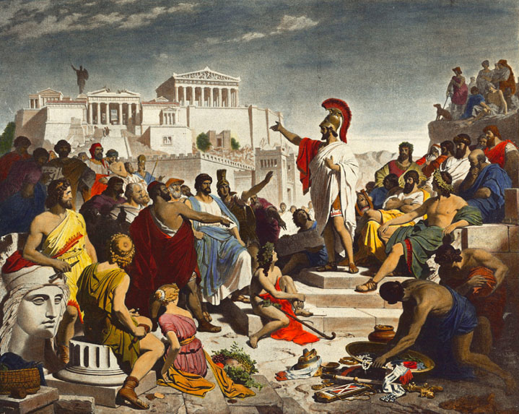
Evolution of Democracy
Democracy in Ancient Time:
In Ancient Greece, the people of the city-state of Athens developed a way of Making decisions that was different from autocratic way of the past.
Athens was the first city-state to allow ordinary citizens access to government offices and courts.
Herodotus, the Greek historian includes equality before the law, popular participation in decision-making, and popular control of public officials in the maxim of the rule of the people.
But thinkers like Plato and Aristotle are hostile to the idea of democracy.
Later ancient philosophers like Polybius, Cicero and Saint Augustine sought to carry forward the ideal of the mixed constitution by subordinating the rulers to virtue or to the law which was exalted to be above the rule of men.

Slide 5
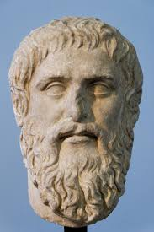
Plato on Democracy
Plato had a complex and critical view of democracy, which was expressed in his work “The Republic."
Plato was deeply skeptical of democracy as a form of government, arguing that it was unstable and prone to mob rule.
According to Plato, democracy arose as a reaction to the excesses of oligarchy, or government by the few.
In a democracy, power is vested in the people, who are free to do as they please. However, this freedom can lead to chaos and the erosion of social order, as people are guided by their passions and desires rather than by reason and justice.
Plato believed that democracy could lead to a situation where decision-making is influenced by the uninformed or those lacking expertise.

Slide 6
Cont..
He argued that in a democratic system, decisions are often made based on the whims of the majority rather than on reasoned judgment or knowledge.
Plato criticized the process of leadership selection in democracies. He believed that in democratic societies, leaders are often chosen based on popularity rather than on merit or qualifications.
Plato viewed democracy as inherently unstable and prone to disorder. He argued that democratic societies are characterized by constant flux and change, as competing interests and factions vie for power.
This instability, according to Plato, can undermine the effectiveness of governance and lead to social unrest.

Slide 7
Cont..
Plato saw democracy as a stage in the degenerative cycle of political systems.
In "The Republic," he describes how democracy can devolve into tyranny through a process of decay, as citizens prioritize personal gratification and hedonism over civic virtue and the common good.
Instead of democracy, Plato advocated for a form of government led by philosopher-kings—wise and virtuous rulers who govern with knowledge and reason.
He believed that such rulers would be better equipped to make decisions in the interest of the whole society, rather than succumbing to the whims of the masses.

Slide 8
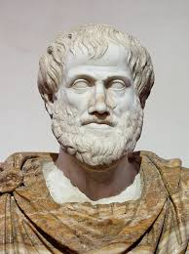
Aristotle on Democracy
According to Aristotle, democracy was one of several forms of government, alongside oligarchy (government by the few) and monarchy (government by one).
He criticised democracy for its tendency towards excessive freedom, which he believed could lead to lawlessness and the erosion of social order. He argued that in a democratic system, the majority could easily oppress the minority, leading to injustice and instability.
Aristotle also recognized the value of democracy as a system that allowed for the participation of the many in the political process.

Slide 9
Cont..
Aristotle distinguished between different forms of democracy, including direct democracy and representative democracy.
He recognized that in a direct democracy, where citizens directly participate in decision-making, there is a risk of majority tyranny and instability.
However, he also acknowledged that in a representative democracy, where citizens elect representatives to make decisions on their behalf, there is a greater potential for moderation and stability.
Aristotle believed that the best form of democracy was one that was characterized by a strong middle class.
He argued that when the middle class is predominant, it acts as a moderating force, preventing the extremes of wealth and poverty that can lead to social unrest and political instability.

Slide 10
Cont..
Aristotle advocated for a mixed constitution that combines elements of democracy, aristocracy, and monarchy.
He believed that such a constitution could balance the competing interests of different social classes and promote the common good.
Aristotle saw the mixed constitution as a way to mitigate the weaknesses of pure democracy, such as majority tyranny and instability.
Unlike Plato, who favored rule by a philosopher-king elite, Aristotle emphasized the importance of citizen participation in governance. He believed that democracy could promote civic virtue and political engagement among citizens, thereby strengthening the polis (city-state) as a whole.
However, Aristotle also recognized that for democracy to function effectively, citizens must possess the virtues of moderation, prudence, and justice.
Aristotle argued that political agitators, who appeal to the passions and prejudices of the masses, can undermine the principles of democracy and lead to tyranny. Aristotle believed that institutions and laws should be established to prevent the rise of agitators and protect against the abuse of power.

Slide 11
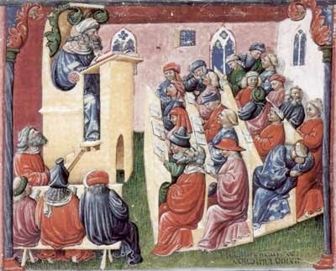
Democracy in Medieval times/ Middle Ages:
The Middle Ages was a period of European history from the fall of the Roman Empire (476 AD) until the fall of Constantinople in 1453 AD. It is also known as the Dark Age.
The Middle Ages are significant for emphasising the conception of a moral law of nature, the quest for a universal society, and the belief in the dignity of the individual.
Although there was not a democracy directly in place of the Middle Ages, Christianity was widely followed and so many democratic ideas were understood and followed by many people.
St. Thomas Aquinas, the eminent thinker of the 13th century did talk of human law, though he regarded it as inferior to the eternal law of God.
Martin Luther (1483-1546) eliminated the Church as the intermediatory between individual and creator.
The Middle Ages saw a period of feudalism and monarchies, with little to no democratic governance.

Slide 12
Saint Augustine on Democracy
Augustine, who lived in the 4th and 5th centuries AD, was more concerned with the relationship between the individual and God, and the role of the state in upholding moral and ethical principles.
He believed that the state had a role to play in maintaining order and justice, but that its ultimate purpose was to serve the common good and to uphold the moral and ethical laws of God.
He argued that any form of government must be guided by moral and ethical principles, and that the ultimate purpose of governance is to serve the common good.

Slide 13
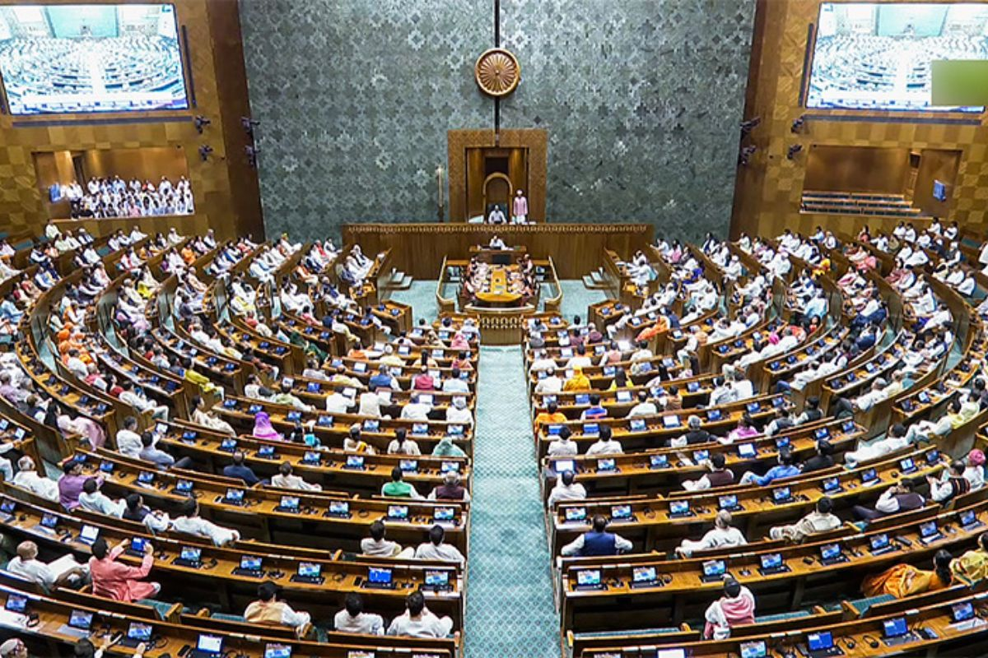
Democracy in modern times:
The Renaissance led to further the expression of individualism- the discovery of human beings and the emphasis of self-expression, self-realization and self-fulfilment.
Machiavelli and Montesquieu took democracy to be a pure form of government that could be safely incorporated into statecraft only as one component of a mixed republican institution.
Thomas Hobbes developed the concept of the state through its element of sovereignty(the ruler as sovereign fitting neatly into the scheme of monarchical absolutism).
In 17th and 18th centuries challenged the notion of absolute sovereignty by the social contract theorists.
The early exponents of social contract theory Hobbes and Locke sought to base political legitimacy on the consent of the individuals and challenged traditional dictatorship and the divine right of the king.

Slide 14
Cont..
Both Locke and Rousseau laid emphasis on the freedom, dignity and rights of the individual. They also viewed that the state as the result of individuals consent and agreement and act as a means for the individual and community.
Rousseau introduced the idea of Popular sovereignty and became the early theorist of democracy.
The English, the American and the French Revolutions of the 17th and 18th centuries gave concrete reality to the social contract ideas as it came to be built in the West.
Alexis de Tocqueville and J S Mill systematically elaborated the concept of democracy in their writings.
In the liberal-democratic world of the West, democracy was a later addition in their liberal ethos.Three features like, participation, control and welfarism were incorporated in their constitutions for following the attainment of national sovereignty.
Newer ways of democracy swept across Europe in the 1970s and 80s when representative governments were instituted in the nations of southern, central and eastern Europe and other parts of the World.

Slide 15
Machiavelli on Democracy
Machiavelli believed that the state was a necessary institution for maintaining order and security, and that the primary responsibility of the ruler was to ensure the security and well-being of the state.
He argued that the ruler must be willing to use any means necessary to maintain power and to ensure the security of the state, including the use of force and deception.
Machiavelli also believed in the importance of the rule of law, and he argued that the state must uphold the law in order to maintain order and justice.
He also believed that the ruler must be willing to suspend the law in times of crisis, in order to maintain the security of the state.
The state must be guided by the principles of realism and necessity, and that the ultimate purpose of governance is to ensure the security and well-being of the state.

Slide 16
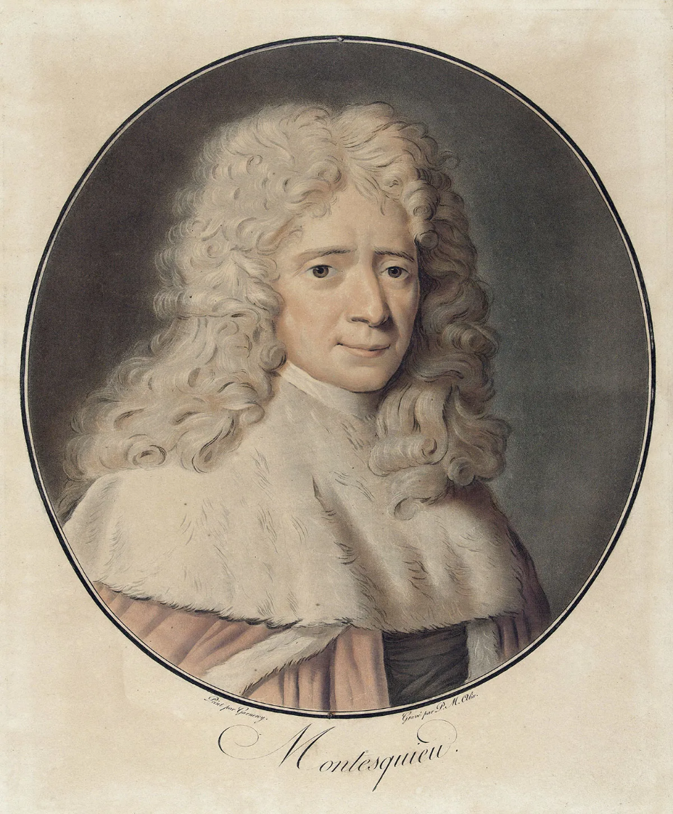
Montesquieu
Montesquieu, a prominent French philosopher of the Enlightenment era, advocated for dividing governmental authority into three branches—executive, legislative, and judicial—to prevent any one branch from becoming too powerful and potentially tyrannical. This system of checks and balances was essential for maintaining liberty within a democratic society.
Montesquieu distinguished between different forms of government, including monarchy, despotism, and republicanism.
He argued that democracy was most viable in small, homogeneous communities where citizens shared common values, interests, and concerns. He was skeptical about the feasibility of democracy in large, heterogeneous societies due to the challenges of representation and governance.
He emphasized the importance of civic virtue and active citizenship in sustaining a democratic society. Without a virtuous citizenry, democracy could degenerate into chaos or authoritarianism.

Slide 17
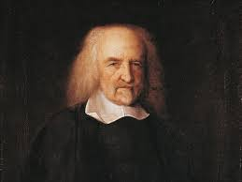
Thomas Hobbes
Hobbes famously described the state of nature as a condition of "war of every man against every man," where life was "solitary, poor, nasty, brutish, and short."
In this state, individuals pursue their self-interests without regard for others, leading to conflict and insecurity.
Hobbes argued that to escape the state of nature and secure peace and order, individuals voluntarily entered into a social contract with one another and with a sovereign authority.

Slide 18
Cont..
This sovereign, whether a monarch or an assembly, possessed absolute power to maintain law and order and protect the people from their own destructive tendencies.
Hobbes vision of political authority was authoritarian, with the sovereign holding absolute power over the state.
He believed that a strong, centralized government was necessary to prevent chaos and ensure stability.
Hobbes' political philosophy leaned toward authoritarianism and centralized power.

Slide 19
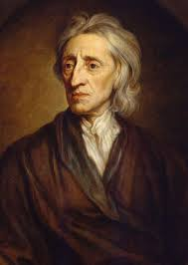
John Locke
State of Nature: Like Hobbes, Locke theorized about the state of nature, but he portrayed it as a condition of natural rights and equality rather than perpetual conflict.
In Locke's view, individuals were endowed with certain natural rights, including life, liberty, and property, and had the capacity to govern themselves reasonably and fairly.
Social Contract: Locke also believed in the social contract, but he envisioned it differently from Hobbes.
For Locke, the social contract was a mutual agreement among individuals to form a government for the protection of their natural rights.

Slide 20
Cont..
Unlike Hobbes' absolute sovereign, Locke proposed a limited government with powers derived from the consent of the governed.
Limited Government: Locke advocated for a government with limited powers, specifically tasked with protecting the rights of individuals.
He emphasized the importance of separation of powers, checks and balances, and the rule of law as essential principles of governance.
While Locke did not advocate for democracy in the modern sense, his ideas laid the groundwork for liberal democratic principles, including representative government and individual rights.

Slide 21
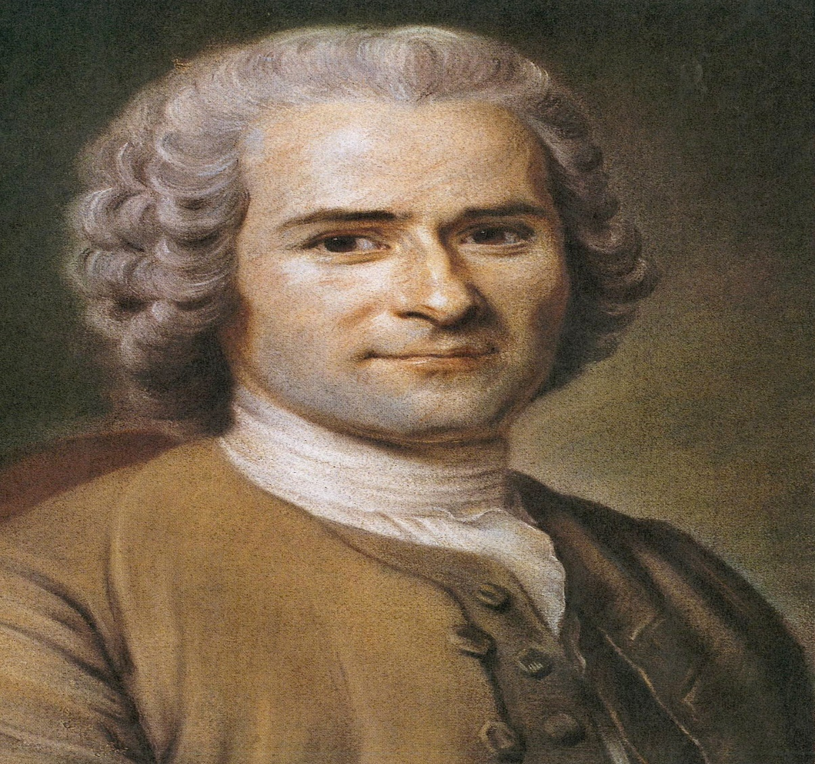
Rousseau
Rousseau's conception of democracy is characterized by the notion of popular sovereignty and direct citizen participation.
Rousseau posited the concept of the "general will," which he considered as the collective expression of the common good and the true will of the people.
According to Rousseau, the general will represents what is best for the community as a whole, transcending individual interests and preferences.
Rousseau championed the idea of popular sovereignty, asserting that ultimate political authority resides in the people themselves.
In his view, individuals must collectively participate in the formation of laws and policies, thereby exercising self-governance and determining their own destiny.

Slide 22
Cont..
Rousseau advocated for a form of direct democracy, wherein citizens directly participate in decision-making processes rather than delegating authority to representatives.
He believed that direct democracy was essential for preserving the integrity of the general will and preventing the corruption of political institutions by self-interested elites.
Rousseau emphasized the importance of civic virtue and active citizenship in a democratic society.
He argued that citizens must prioritize the common good over personal interests and actively engage in public affairs to ensure the legitimacy and effectiveness of the political system.

Slide 23
Cont..
Rousseau suggested that direct democracy is most feasible in small, homogeneous communities where citizens share common values and interests.
In such communities, individuals are more likely to identify with the collective will and participate actively in political life.
Despite his advocacy for democracy, Rousseau recognized certain limitations and challenges associated with direct democracy.
He acknowledged the potential for tyranny of the majority and the risk of individuals prioritizing their own interests over the common good. Nonetheless, Rousseau believed that these risks could be mitigated through education, civic engagement, and the cultivation of moral character.

Slide 24
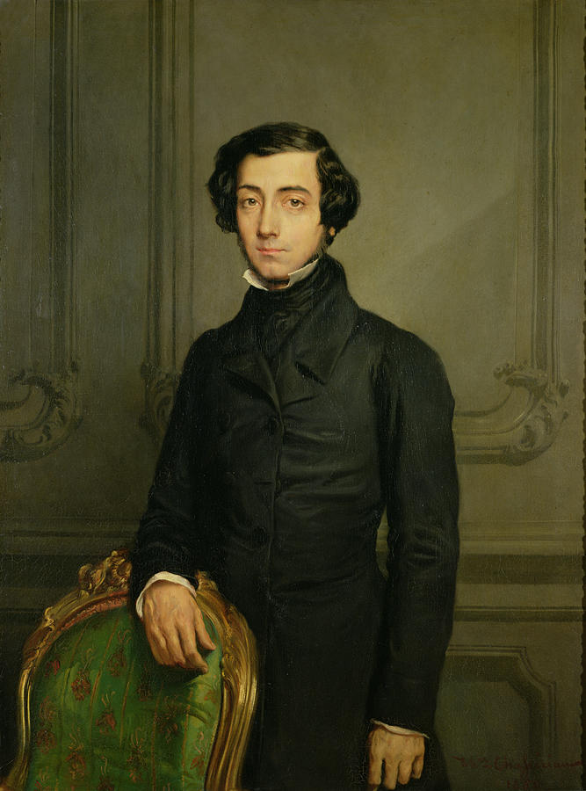
Alexis de Tocqueville
Tocqueville, a French political thinker, admired democracy but warned of its potential pitfalls, particularly the tyranny of the majority and the threat of mediocrity.
He observed the importance of civil society and voluntary associations in maintaining democracy's vitality and mitigating the dangers of individualism.
Tocqueville's work "Democracy in America“(1835 & 1840) remains a seminal exploration of the strengths and weaknesses of democratic societies.
Tocqueville was concerned about the potential for majority tyranny in democratic societies. He observed that in democratic systems, where power is vested in the majority, there is a risk that the majority might oppress minority groups or individuals.

Slide 25
Cont..
Tocqueville recognized the trend towards greater social equality in democratic societies.
He observed that the leveling of social hierarchies could lead to a more egalitarian society, but he also cautioned that this equality might result in a form of "soft despotism" where individuals become passive and dependent on the state.
Tocqueville emphasized the importance of civil society as a check on government power in democratic societies.
He praised the vibrant associational life in America, where citizens formed voluntary associations to pursue common interests and address social needs. Tocqueville saw these associations as essential for maintaining individual freedom and preventing the centralization of power.
Tocqueville favored decentralization and local self-government as a means of fostering civic participation and political engagement.

Slide 26
Cont..
He believed that local communities provided opportunities for citizens to actively participate in governance and develop a sense of civic responsibility.
Tocqueville noted the prevalence of individualism in American society, which he saw as both a strength and a potential weakness of democracy.
While individualism encouraged innovation, entrepreneurship, and personal freedom, Tocqueville also warned that excessive individualism could lead to social fragmentation and a loss of community cohesion.
Tocqueville stressed the importance of strong institutions, including an independent judiciary, a free press, and a robust system of checks and balances, in preserving democratic governance.
He argued that these institutions were necessary for maintaining political stability and preventing the concentration of power.

Slide 27
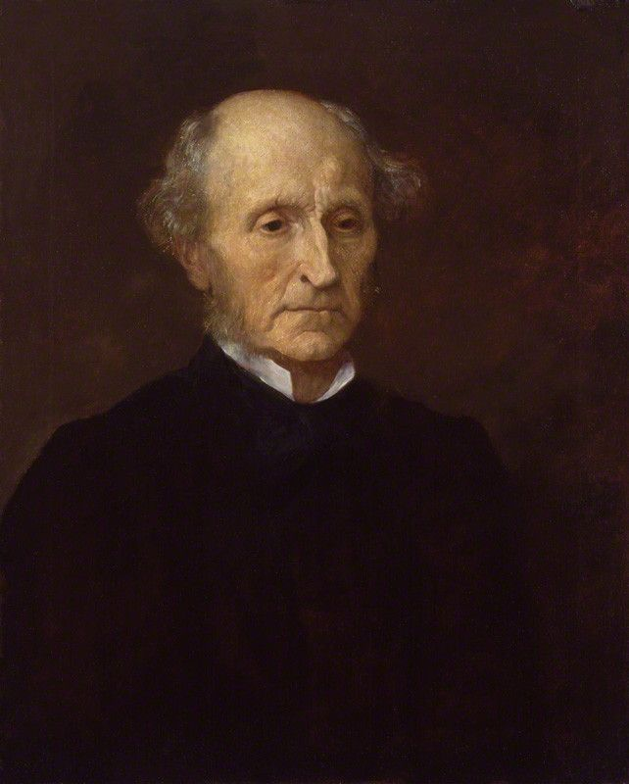
John Stuart Mill
Mill was a proponent of liberal democracy and individual freedom.
He argued for the importance of civil liberties, including freedom of speech, freedom of association, and freedom of conscience, as essential components of a healthy democracy.
In his famous Mill also emphasized the need to protect minority rights and encouraged active citizen participation in political decision-making processes.
work "On Liberty," Mill stressed the importance of limiting the power of government and society over the individual, even in a democratic system.

Slide 28
Cont..
He warned against the "tyranny of the majority," where the majority could oppress minority voices. He believed that democracy should be supplemented with mechanisms to safeguard individual freedoms, such as constitutional protections and checks and balances.
Mill emphasized the importance of education and informed participation in a democratic society. He believed that an educated electorate was essential for the success of democracy, as it would lead to more rational decision-making and better outcomes for society as a whole.
Mill supported representative democracy, where elected representatives make decisions on behalf of the people.
Mill emphasized diversity of opinions and believed that it enriched democratic deliberation. He argued that allowing different voices to be heard was essential for the progress of society and the discovery of truth.

Slide 29
Definitions
MacIver: Democracy is a form of state is merely a mode of appointing, controlling and dismissing a government.
Gettel: Democracy is that form of government in which masses of the population possesses the right to share in the exercise of sovereign power.
Bryce: Democracy means nothing more or less the rule of the whole people, expressing their sovereign will by their votes.
Seeley: Democracy is that system of government in which everyone has a share.
Bryce: Democracy is that form of government in which the ruling power of a state is legally vested, not in any particular class or classes but in the members of the community as a whole.

Slide 30
Deliberative democracy

Slide 31
Introduction
Definition: Deliberative democracy is a form of democracy in which deliberation is central to decision-making. It involves the careful discussion and consideration of different viewpoints before arriving at a decision.
Core Idea: Unlike traditional forms of democracy that focus primarily on voting, deliberative democracy emphasizes informed and reflective discussions among citizens, aiming to reach a consensus or a well-reasoned decision.
Explanation: This slide provides the basic definition and core idea behind deliberative democracy. The audience learns that this model prioritizes discussion and thoughtful debate over simple majority rule.

Slide 32
Key Features of Deliberative Democracy
Inclusiveness: All relevant stakeholders or citizens have the opportunity to participate and share their views.
Equality: Participants in deliberation are treated as equals, with no one’s opinion considered more important than another’s.
Reasoned Debate: Discussions are grounded in logic, evidence, and well-thought-out arguments, rather than emotion or rhetoric.
Transparency: The process is open and transparent, allowing public scrutiny and understanding of how decisions are made.
Explanation: This slide breaks down the essential characteristics that define deliberative democracy. Each feature ensures that the decision-making process is fair, open, and based on reasoned argumentation.

Slide 33
Historical Background
Origins: The roots of deliberative democracy can be traced back to ancient Athenian democracy, where public debate and discussion were integral to governance.
Modern Revival: In the 20th century, political theorists like Jürgen Habermas and John Rawls brought renewed attention to deliberative democracy, arguing for its importance in modern political systems.
Explanation: This slide gives a brief history of deliberative democracy, showing its ancient origins and its revival in modern political theory. The historical context helps the audience appreciate how the concept has evolve.

Slide 34
Key Theorists
Jürgen Habermas: Known for his concept of the public sphere, where individuals engage in rational-critical debate. He argues that democracy should be rooted in communicative rationality, where the force of the better argument prevails.
John Rawls: Introduced the idea of "public reason," where citizens engage in discourse that others can reasonably endorse. He emphasized fairness and justice as key components of deliberation.
Explanation: This slide introduces key figures who have shaped the theory of deliberative democracy. Understanding their contributions helps the audience grasp the intellectual foundations of the concept.

Slide 35
Deliberative Processes
Citizens' Assemblies: Groups of citizens are randomly selected to deliberate on specific issues. They receive information from experts, discuss the matter, and then make recommendations.
Public Consultations: Governments or organizations gather public input on policy decisions through forums, town halls, or surveys, allowing citizens to voice their opinions.
Deliberative Polls: Participants are polled on an issue before and after they engage in detailed discussions, revealing how deliberation influences public opinion.
Explanation: This slide highlights practical applications of deliberative democracy, showcasing how it is implemented in real-world scenarios. The audience learns about different methods of fostering deliberation among citizens.

Slide 36
Advantages of Deliberative Democracy
Informed Decision-Making: Encourages participants to be well-informed before making decisions, leading to more thoughtful and sustainable outcomes.
Legitimacy: Decisions are more likely to be accepted and respected when they result from a fair and transparent deliberative process.
Conflict Resolution: Deliberation helps to bridge differences, allowing opposing sides to understand each other’s perspectives and find common ground.
Explanation: This slide outlines the benefits of deliberative democracy, emphasizing how it can lead to more informed, legitimate, and peaceful decision-making processes.

Slide 37
Challenges
Time-Consuming: Deliberative processes require significant time, which can slow down decision-making and may be impractical in urgent situations.
Practicality: Scaling deliberative democracy for large populations can be difficult, requiring extensive resources and coordination.
Inequality in Participation: Despite efforts to include all voices, some groups (especially marginalized ones) may still struggle to be heard, leading to unequal influence in deliberations.
Explanation: This slide discusses the limitations and challenges of deliberative democracy, providing a balanced view of its application. The audience gains an understanding of potential obstacles in implementing deliberative processes.

Slide 38
Case Studies
Irish Citizens' Assembly: A successful example where a group of citizens deliberated on major issues like same-sex marriage and abortion, leading to constitutional changes.
Participatory Budgeting in Porto Alegre, Brazil: An example of deliberative democracy in action, where citizens directly decided on the allocation of a portion of the city’s budget.
Explanation: This slide provides concrete examples of deliberative democracy in action, illustrating its impact and effectiveness in real-world contexts. Case studies help the audience visualize how these ideas can be implemented successfully.

Slide 39
Conclusion
Summary: Deliberative democracy offers a richer, more inclusive form of democratic engagement, promoting informed decision-making and public legitimacy.
Future Prospects: With the rise of digital platforms, there is potential for wider adoption of deliberative democracy, but challenges such as inequality and scalability need to be addressed.
Explanation: The conclusion summarizes the key points covered in the presentation and looks ahead to the future of deliberative democracy. It encourages the audience to consider both the potential and the challenges of this democratic model.

